Slide 1
Title:
Data Science and Business Analytics Internship

Slide 2
Overview
Starting date
September 1, 2021
Duration
1 month
Organization
The Sparks Foundation
Graduate Rotational Internship Program

Slide 3
Stock Market Prediction
News and Historical Sensex datasets were used.
The subjectivity and polarity of news articles is determined using sentiment analysis.
Using sentiment intensity analysis, the correlation between sensex and each news article is determined.
Newsdata set is collected from finance.yahoo.com.
The stock to predict and analyze is SENSEX.

Slide 4
Stock Market Prediction
The two datasets were then merged through inner join for training.
The dataset is then used for training different machine learning models, namely Random Forest Regression, Decision Tree Regression and XGBoost Regression.
The mean squared error between the predictions and the actual outputs in the test data were compared.

Slide 5
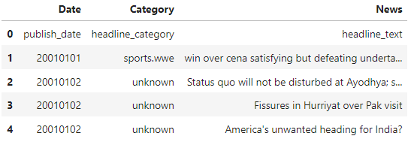
Dataset

Slide 6
Initially using only the sensex dataset an ARIMA Model was trained.
Then the root mean square error was calculated using the test dataset.
Including the news data in the dataset reported a significant decrease in the mean square error and led to more accurate predictions.

Slide 7
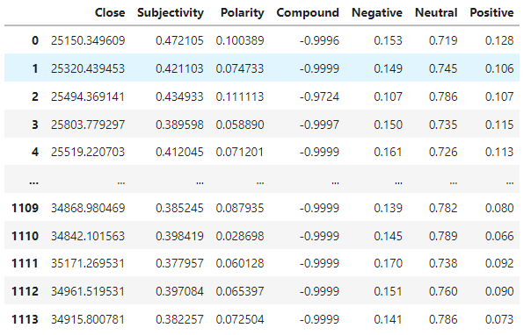
Merged Dataset

Slide 8
Exploratory data Analysis on Superstore
The dataset consisted of sales data from a sample superstore in terms of ship mode, the category and sub-category of sold products, discount applied on each sold product and the profit obtained from it
It also specified the type of customer who bought the product along with the quantity of each product
Z-score was calculated based on the value of ‘Sales’ attribute and outliers were detected and removed from the dataset whose Z-score was out of bounds(Z-score<3)

Slide 9
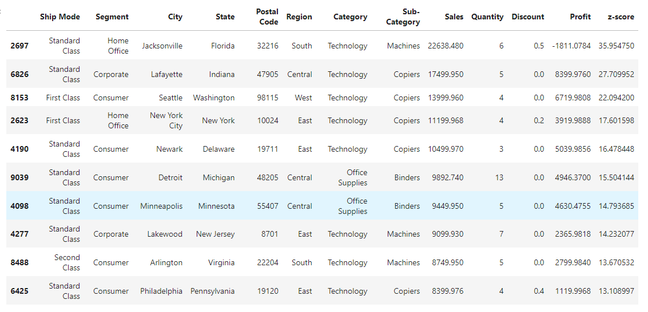

Slide 10
Skills Learned
Working with data and data cleansing
Using various data visualization libraries in python
Handling Textual Data.
Training and evaluating the performance of machine learning models
Usage of various parameters such as correlation coefficient,RMSE,Z-Score.

